Slide 1
UNITING CHURCH IN AUSTRALIA ASSEMBLY
WEEKLY POWERPOINT
1-7 FEB 2023

Slide 2
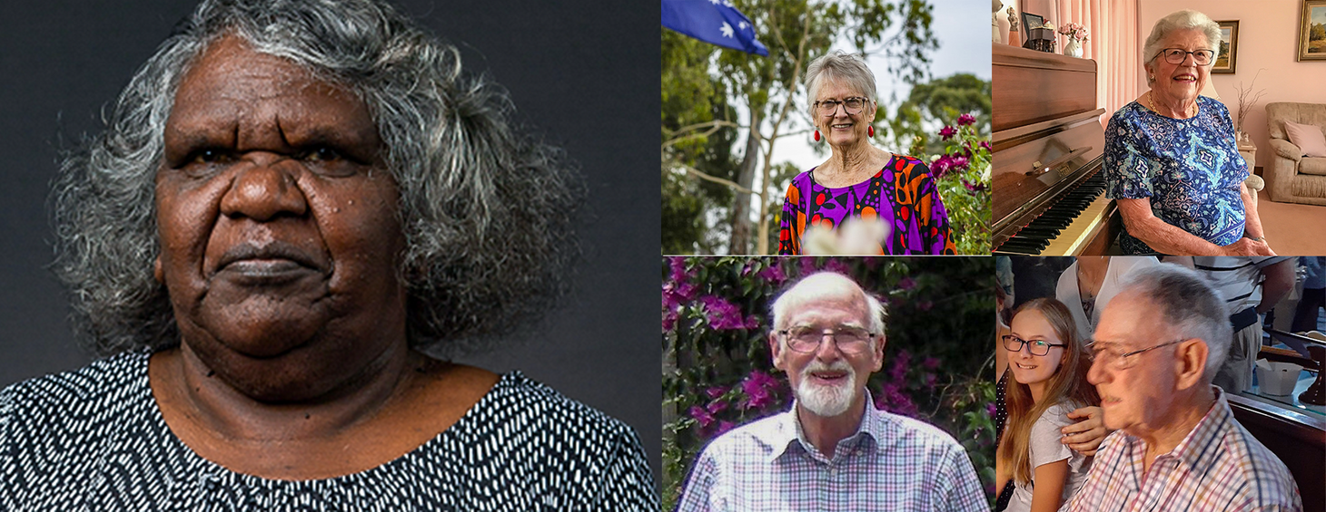
UNITING CHURCH IN AUSTRALIA ASSEMBLY
WEEKLY POWERPOINT
FEATURED STORY
A First Nations community leader, a 91-year-old Church Elder, a pipe organist whose service spans half a century, an accountant and a church volunteer of 60 years are among the Uniting Church members recognised with Australia Day honours. We highlight some of the deserving recipients from across the UCA who have contributed selflessly to the community, some over many decades! Click on the image to go to the story.

Slide 3
UNITING CHURCH IN AUSTRALIA ASSEMBLY
WEEKLY POWERPOINT
RESOURCES
COVENANTING BANNER
RESOURCE OF THE WEEK
One way to acknowledge the First Peoples in your area is to display a Covenanting Banner acknowledging Country and celebrating the Uniting Church's Covenanting relationship with the Uniting Aboriginal and Islander Christian Congress. If you would like to commission a Covenanting pull-up banner for your church, send us the names of the traditional owners of the land you worship on. We’ll send you the design to printed at Officeworks. Send requests with name of the Country you are on to comms@nat.uca.org.au
Calendar of Dates
Lectionary

Slide 4
UNITING CHURCH IN AUSTRALIA ASSEMBLY
WEEKLY POWERPOINT
PRAYER POINTS
Uniting Church members acknowledged in the 2023 Australia Day honours and all in the UCA who selflessly offer their time and gifts in service to our Church and communities.
All those impacted by flooding and extreme weather in Auckland, and for the families of those who have died.
Algeria, Libya, Morocco, Western Sahara, Tunisia, as part of the WCC Ecumenical Prayer Cycle.

Slide 5
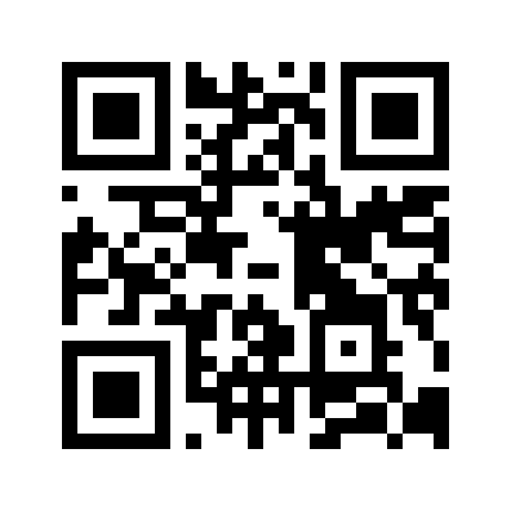
UNITING CHURCH IN AUSTRALIA ASSEMBLY
WEEKLY POWERPOINT
CONNECT WITH US
Scan the QR code to register for the National Update and get your weekly fix of news and resources from across the Uniting Church in Australia.

