Slide 1
A Voice to Parliament
Walking Together BUC 12th September 2022

Slide 2
Acknowledgement of Country
We acknowledge and respect the Wurundjeri people of the Kulin nation, the traditional custodians of this land since time immemorial. We are learning that the land is not ours to own, but to look after; and that if we listen, we may hear in it the calling of the eternal Spirit. Responding to this call, we commit ourselves to work for justice, reconciliation, and care of the earth.

Slide 3
What is/could be a Voice to Parliament?

Slide 4
Called for in the Uluru Statement from the Heart:
“We seek constitutional reforms to empower our people and take a rightful place in our own country…
We call for the establishment of a First Nations Voice enshrined in the Constitution.”
Source: https://fromtheheart.com.au/explore-the-uluru-statement/#statement

Slide 5
As described by ‘From the Heart’…
Source: https://fromtheheart.com.au/what-is-a-voice-to-parliament/

Slide 6
As described by ‘From the Heart’…
“Self-determination, rather than symbolism”
Enshrined in the Constitution
“Would enable Aboriginal and Torres Strait Islander people to give advice to the Federal Parliament about laws and policies that impact them through a simplified policy making process and structural change.”
“real and practical advice”
Source: https://fromtheheart.com.au/what-is-a-voice-to-parliament/

Slide 7
Prime Minister Albanese’s proposal…
Framed as a ‘starting point’ to initiate dialogue, rather than anything ‘final’
Proposed referendum question:
‘Do you support an alteration to the constitution that establishes an Aboriginal and Torres Strait Islander Voice?’
Proposed three sentences to be added to the constitution:
There shall be a body, to be called the Aboriginal and Torres Strait Islander Voice.
It may make representations to parliament and the executive government on matters relating to Aboriginal and Torres Strait Islander peoples.
The parliament shall, subject to this constitution, have power to make laws with respect to the composition, functions, powers and procedures of the Aboriginal and Torres Strait Islander Voice.

Slide 8
It will not be:
A third chamber of parliament
A decision-making body
Source: https://www.dailymail.co.uk/news/article-11166317/Greens-Senator-Lidia-Thorpe-labels-Voice-Parliament-referendum-waste-money.html
And:
“The voice would be able to table formal advice in parliament, and a parliamentary committee would consider that advice. But all elements would be non-justiciable, meaning that there could not be a court challenge and no law could be invalidated based on this consultation.”
Source: https://www.theguardian.com/australia-news/2022/aug/28/how-would-an-indigenous-voice-work-and-what-are-people-saying-about-it?CMP=Share_AndroidApp_Other&fbclid=IwAR25hsepf8NvEX3H9M55AlrPn6Lm1B_YT9QvhlKcbjosJ1Akp8pPj7q4tDA

Slide 9
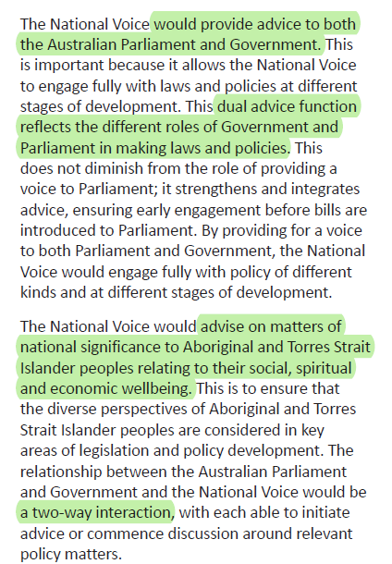
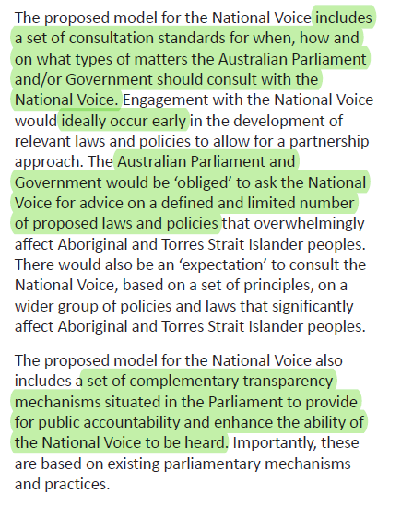
Indigenous Voice Co-design Process Final Report

Slide 10
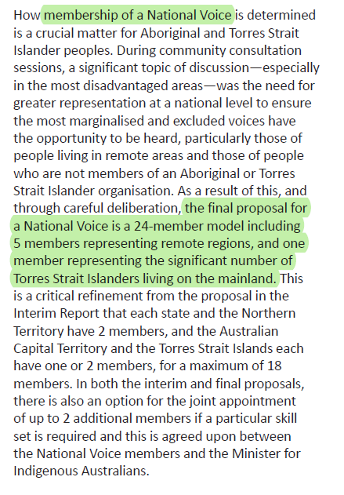

Slide 11
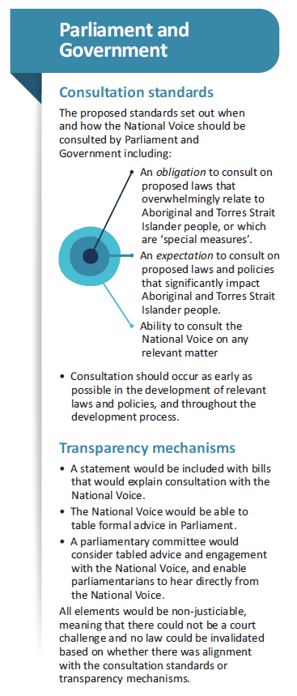

Slide 12
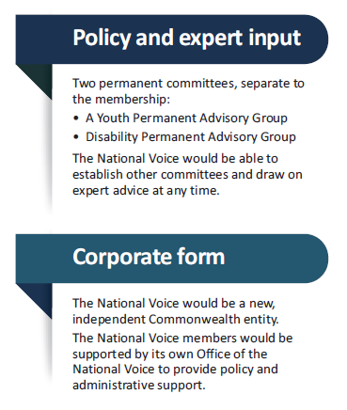
Source: https://voice.niaa.gov.au/#

Slide 13
Important to note that these are all proposed ideas, structures and processes – which may inform the final Voice but are not currently set in stone

Slide 14
Why is it important?

Slide 15
From the Heart says:

Slide 16
Referendum

Slide 17
Why do we need it?
A referendum is required in order to enshrine a Voice to Parliament into the Australian Constitution
This is important for a dependable, long-term Voice, as it ensures that future Governments cannot remove it (without another referendum)

Slide 18
How does it work?
All Australian citizens will be required to vote – answering ‘Yes’ or ‘No’ to a simple question
Requires a ‘double majority’ to pass (majority of citizens and majority of states)
8 out of 44 proposed constitutional changes have passed
https://youtu.be/ZiNb9c4Z-J8?list=TLGG0fj4Ze_X5SowNzA5MjAyMg
Source: https://www.aec.gov.au/elections/referendums/#:~:text=Enrolling%20to%20vote%20in%20a,your%20current%20electoral%20enrolment%20online.

Slide 19
Consultation and development process
We are currently in the education, consultation and development stage (as we lead up to a possible referendum)
““I’ve had discussions with churches, I’ve had discussions with the AFL, with the National Rugby League, with basketball organisations, with netball, with other sporting organisations,” Albanese said.
“We want to engage with people who can connect with young people in particular, but with all sections of our society.””
If anyone has more info on how the consultation etc is being done, please feel free to chime in!
It will probably draw on the work done in the Indigenous Voice Co-Design report
Source: https://www.theguardian.com/australia-news/2022/aug/28/how-would-an-indigenous-voice-work-and-what-are-people-saying-about-it?CMP=Share_AndroidApp_Other&fbclid=IwAR25hsepf8NvEX3H9M55AlrPn6Lm1B_YT9QvhlKcbjosJ1Akp8pPj7q4tDA

Slide 20
What are people saying about it?

Slide 21
Opposition leader…
Source: https://www.theguardian.com/australia-news/2022/aug/28/how-would-an-indigenous-voice-work-and-what-are-people-saying-about-it?CMP=Share_AndroidApp_Other&fbclid=IwAR25hsepf8NvEX3H9M55AlrPn6Lm1B_YT9QvhlKcbjosJ1Akp8pPj7q4tDA

Slide 22
Greens
Greens leader Adam Bandt has released a statement saying the party is committed to negotiating “in good faith”.
“The federal government can make substantial improvements to the lives of First Nations peoples immediately, as we work to progress all elements of the Uluru Statement.”

Slide 23
First Nations voices (examples, not necessarily representative)
Arguments for
Arguments against
Treaty should be first priority, and come before a Voice
Waste of time/money (that could be spent on other things)
Symbolic rather than practical – “too bureaucratic”
Would ‘entrench the idea that Aboriginal people are all victims”
Greens Senator Thorpe and Coalition Senator Jacinta Price
https://www.dailymail.co.uk/news/article-11166317/Greens-Senator-Lidia-Thorpe-labels-Voice-Parliament-referendum-waste-money.html
A Voice could “further [legitimate] the Constitution, a colonial document.”
https://theconversation.com/the-albanese-government-has-committed-to-enshrining-a-first-nations-voice-in-the-constitution-what-do-australians-think-of-the-idea-184841
One step on the journey – cannot be the ‘final’ step, but is a positive one if part of a longer journey (Treaty, Truth-telling etc)
Now that it’s on the table, important to come together and work against a racist ‘no’ campaign
Everything outlined earlier by ‘From the Heart’ in ‘Why it’s important’; and Indigenous Voice Co-Design Report
https://www.theguardian.com/australia-news/2022/sep/06/new-getup-chief-warns-progressive-critics-of-indigenous-voice-against-repeating-racist-no-campaign-messages
Question: How do you think we might act in good allyship – taking into consideration the complexity of diverse voices and opinions within First Nations communities, and taking positive action as best we can?

Slide 24
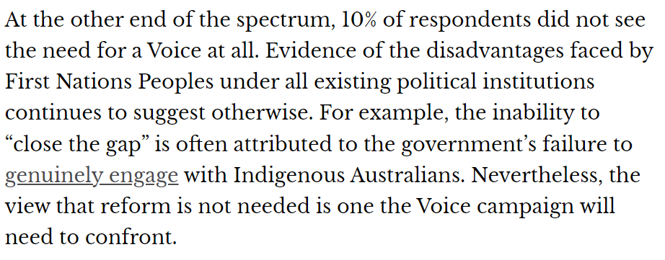
Opposing voices
https://www.theguardian.com/australia-news/2022/aug/28/how-would-an-indigenous-voice-work-and-what-are-people-saying-about-it?CMP=Share_AndroidApp_Other&fbclid=IwAR25hsepf8NvEX3H9M55AlrPn6Lm1B_YT9QvhlKcbjosJ1Akp8pPj7q4tDA
Source: https://www.voanews.com/a/divisions-in-australia-over-plan-for-indigenous-voice-to-parliament/6732931.html
Source: https://theconversation.com/the-albanese-government-has-committed-to-enshrining-a-first-nations-voice-in-the-constitution-what-do-australians-think-of-the-idea-184841

Slide 25
Discussion

Slide 26
What do you think of the idea of a Voice and a referendum?
What are the strengths and weaknesses?
Anything not included in this presentation, that you would like to share?
What is a Christian response?
What do you think about the relationship between Voice and Treaty?

Slide 27
Campaigning

Slide 28
Challenges
Risk of misinformation (and what can be done about it): https://www.theguardian.com/australia-news/commentisfree/2022/sep/07/when-the-indigenous-voice-referendum-is-upon-us-be-wary-of-misinformation-and-scare-campaigns
Lack of knowledge/awareness in the general public
https://theconversation.com/the-albanese-government-has-committed-to-enshrining-a-first-nations-voice-in-the-constitution-what-do-australians-think-of-the-idea-184841
What other challenges do you think there might be?

Slide 29
Source: https://fromtheheart.com.au/uluru-statement/frequently-asked-questions/
Take action:
https://fromtheheart.com.au/take-action/

Slide 31
Action

Slide 32
Are there any actions that we as individuals, Walking Together and/or Brunswick UC are inspired to do?

