Slide 1
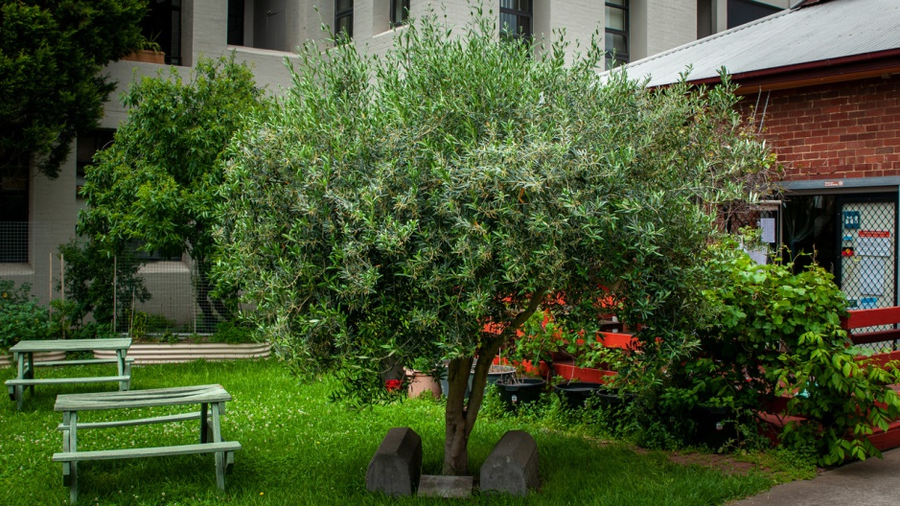
The world is charged with the grandeur of God
For the presence of this olive tree
Thanks be to God

Slide 2
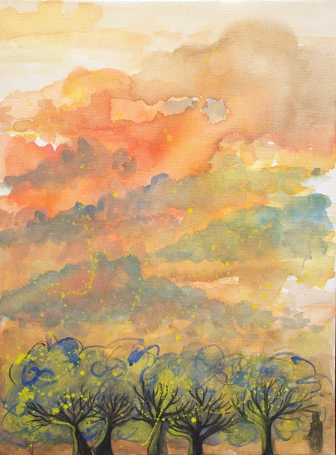
Having a ‘temple tantrum’: resistance, grief and anger

Slide 3
The human world – human domination everywhere - building, tourism, travel, the digital universe. The world getting ‘hotter, smokier, noisier’
The other-than-human world – pushed out, used for human amusement (penguins), wild birds vomiting supermarket shopping bags, above all ‘the vanishing’ – species - gone, gone, gone; or going, going, going.
Something is badly wrong – ‘he felt it as a pain as a sickness growing within him’ – but basically it is ignored, silenced, pushed away.

Slide 4
The parallel between two ailing mothers: mother Francie and Mother Earth. Both dying in ways that run counter to their wishes: medical technology in Francie’s case; climate change in the case of Earth.
The pressure on both mothers stem from the same basic causes – money, power, technology and the human desire to control.
The approach seems ‘immensely crude’ to Anna. But what could be done about it ‘she had no idea’.
The forces of nature, in death and in planetary climate, are beyond human control. Despite our ‘arrogant defiance’ we need to discover ‘an admission of humility’.
The escape into the virtual world as a way of avoiding the actual world.

Slide 5
Modern consumer-driven city life rolls on ‘so many things to be bought and sold’, even when other life (in the family or in nature) ‘just grew too grotesque and terrifying to contemplate.’
The vanishings are not noticed. What is desperately abnormal is normalised, rationalised, or dismissed. ‘Everything wrong was now common sense.’
The ‘wicked problem’ that mustn’t be talked about. Anna struggles to listen to what cannot be said; but ‘each person talked ever more insistently to avoid the possibility of a conversation ever happening’

Slide 6
In the human realm, the contrast between the deaths of mother and daughter – one drawn out, hospitalised, manipulated, technologized; the other quick, natural, surrounded by the sustaining and life generating Earth
In the more-than-human realm, the unexpected reappearance of the orange-bellied parrot, nesting. ‘the world seemed, for no apparent reason, suddenly extraordinarily alive.’
The moment of adoration: connection not separation; gift not greed, gratitude not manipulation. ‘She was, she realised with amazement, not downcast nor defeated.’

Slide 7
What do I feel about all this?
What might this be saying for our community life at BUC?

