Slide 1
The world is charged with the grandeur of God
For the grandeur of this olive tree
Thanks be to God

Slide 2
The Matrix of the Word of God
1. The eternal Word of God: ‘The Word was with God and the Word was God…’ John 1.1
2. The creative Word of God: – ‘All things came into being through him’ John 1.3
3. The prophetic Word of God: ‘Now the word of the Lord came to me saying, …’ Jeremiah 1.4
4. The incarnate Word of God: ‘The Word became flesh and dwelt among us…’ John 1.14
5. The written Word of God –Scripture: ‘All scripture is inspired by God … 2 Timothy 3.16
6. The spoken (preached) Word of God: ‘Preach the word …’ 2 Timothy 4.2
7. The ‘inner’ Word of God: ‘Let the word of Christ dwell in you richly …’ Colossians 3.16

Slide 3
The shock of a ‘second opinion’: reading Job after Genesis

Slide 4
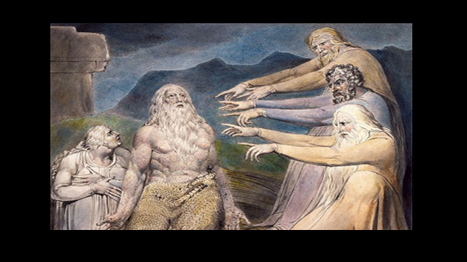

Slide 5
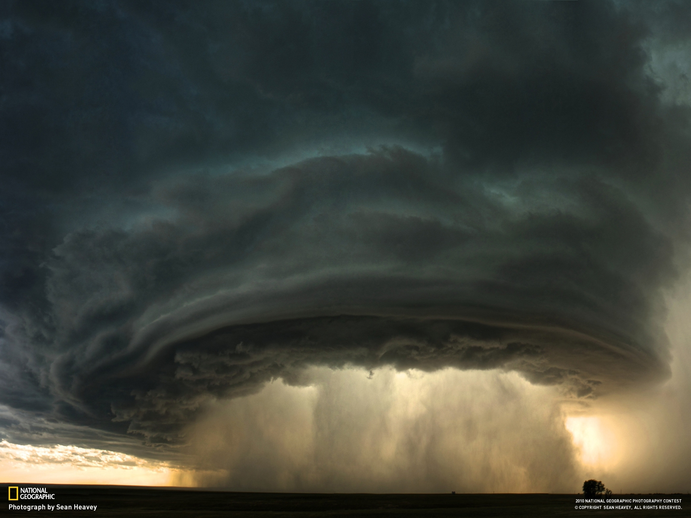
Then the Lord answered Job out of the whirlwind: “who is this that darkens counsel by words without knowledge?” (Job 38.1-2)

Slide 6
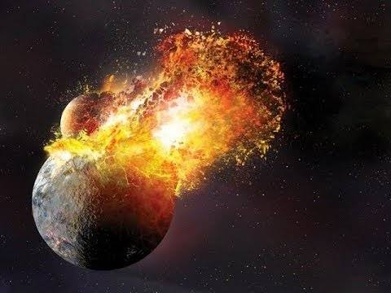

Slide 7
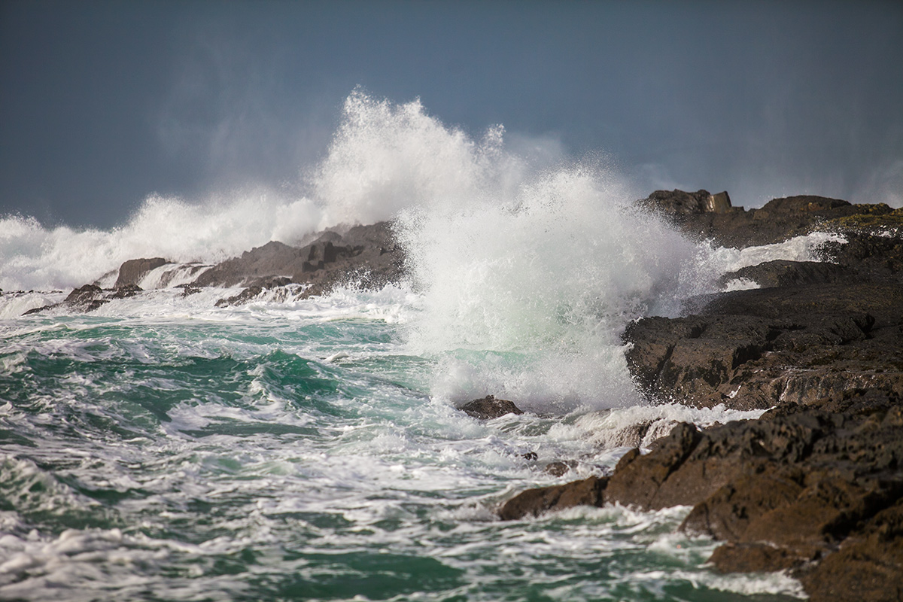

Slide 9
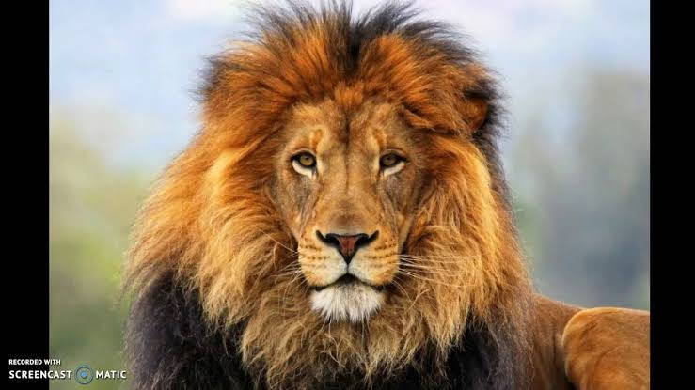
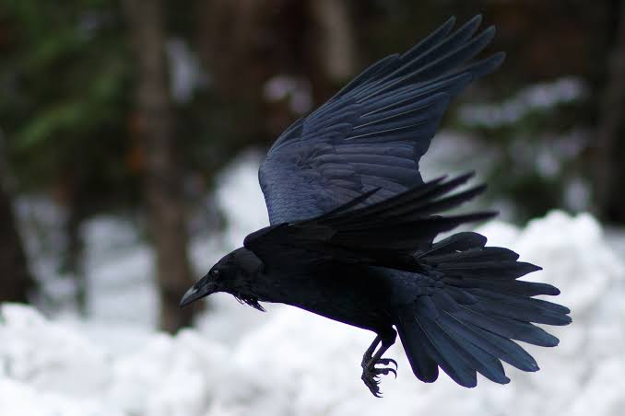
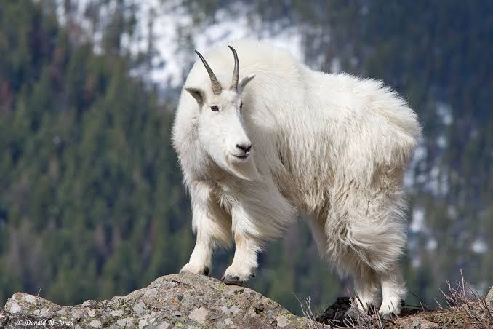
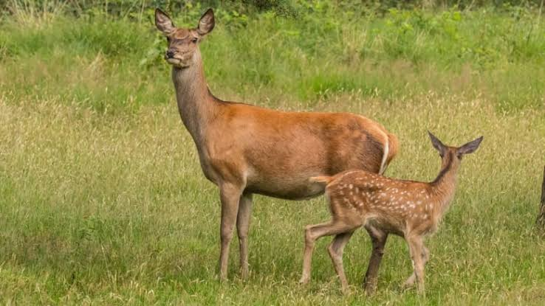
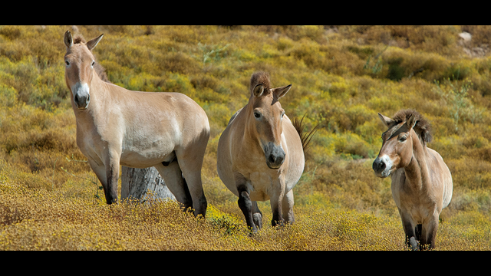
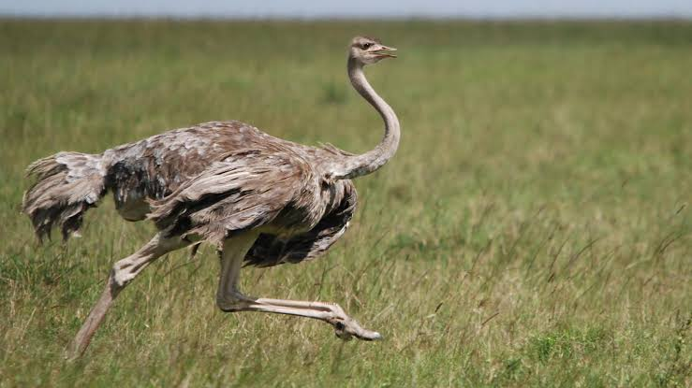
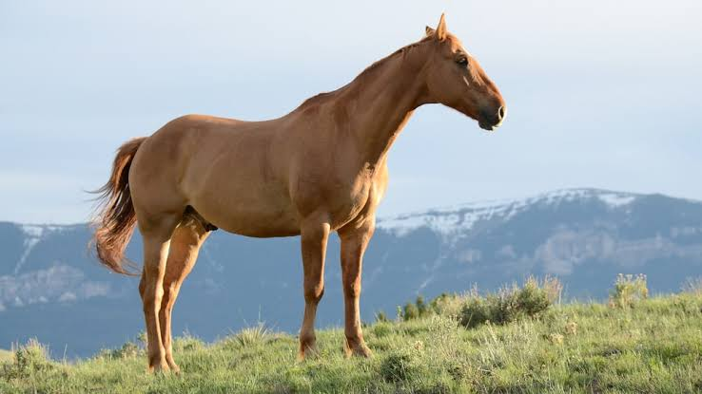
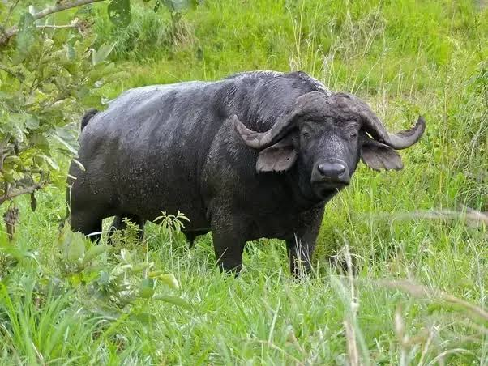
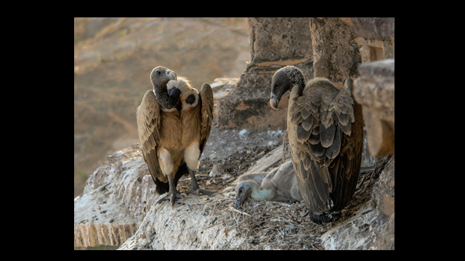
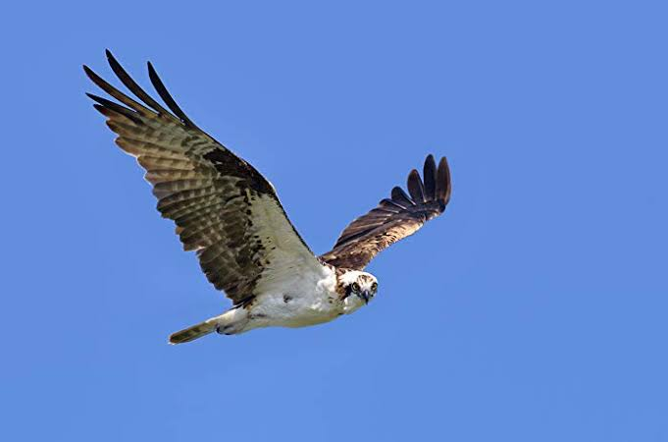

Slide 12
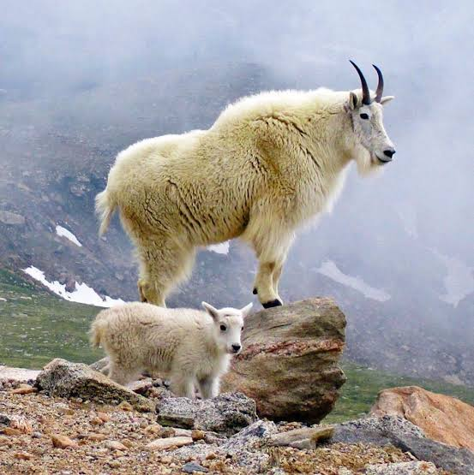

Slide 15
Breakout Room
Pause for a moment and listen to what you are feeling after hearing God’s speeches to Job. (Dimension 7 of our matrix is the inner voice.)
What is Yahweh saying to Job in this speech? (Dimension 5 of the matrix)
What is Yahweh saying to us through this speech today? (Dimension 6 of the matrix)

Slide 16
Yahweh’s Speech to Job – what did we hear?
1. Yahweh is passionately concerned with the whole of Creation, all things great and small. For us to be involved with Yahweh is necessarily to be involved with Yahweh’s intentions and loves
‘We cannot tear ourselves away from the world to offer ourselves to God.’ (J-L Chrétien)
2. We are faced with our human-centredness. We are not the measure or the centre of things
3. These together call us towards change, to some kind of conversion of heart, mind and life – called in the New Testament metanoia (repentance)

Slide 17
Breakout Room
What feelings are evoked in you by this talk?
What parallels do you see between Yahweh’s speech and Sylvia Earle’s?
What differences do you see?

Slide 18
Whirlwind and Water
1. Parallels
Both speeches attend and give voice to a reality far greater than us; a reality in which we humans are embedded and upon which we are dependent
Both reveal a brilliant cosmos of diversity in unity, a grandeur (GM Hopkins) which calls forth from us a sense of wonder and mystery, fear and love
Both affirm that all things (our fellow creatures) have a rightful habitat, intrinsic worth, and vital contribution to make to the whole
Both speeches call humans to account – to acknowledge and respect all things. And to change their ways

Slide 19
Whirlwind and Water
2. Differences
Job cannot answer back to Yahweh’s questions. We can and do.
Job’s self-centredness may have blinded him to the wider context of his life in the whole created order. But it didn’t threaten that order. We can and do. ‘No blue, No green’
There is a difference between theology (Job) and science (Earle). But there is also a fruitful conversation to be had. Here are just three points:
Science is the practice of a detailed, loving, humble attention to the world. The believer can joyfully accept and learn from this.
For the believer, the world is not just the world, however splendid. It is God’s loved creation. The things of the world live first in God’s heart before ever they enter ours. Thus we are called to a way of life marked by reverence, awe, praise and thanksgiving
The repentance called for by Sylvia Earle is broader and deeper than that required of Job.
Sin is not only a personal unfaithfulness to the love that founds the world, not only unjust behaviour toward other humans created in God’s image. It is also a damaging disregard of the order of creation itself.

